Slide 1
第17章 数据分析、科学计算与可视化-3
彭小江，博士，副教授
深圳技术大学
Email: pengxiaojiang@sztu.edu.cn
Homepage: https://pengxj.github.io/
Notes:
很多深度学习书都喜欢用植物或者水果作为代号，如南京大学周志华的西瓜书-机器学习、复旦大学邱锡鹏的蒲公英-神经网络与深度学习，最适合的感觉是榴莲，因为拨起来很费劲，一旦拨开很甜蜜。榴莲课

Slide 2
17.4 数据分析模块pandas
pandas主要提供了3种数据结构：1）Series，带标签的一维数组；2）DataFrame，带标签且大小可变的二维表格结构；3）Panel，带标签且大小可变的三维数组。

Slide 3
17.4 数据分析模块pandas
（1）生成一维数组
>>> import numpy as np
>>> import pandas as pd
>>> x = pd.Series([1, 3, 5, np.nan]) # np.nan表示空值、缺失值
>>> x
0 1.0
1 3.0
2 5.0
3 NaN
dtype: float64

Slide 4
17.4 数据分析模块pandas
# 生成日期时间索引
>>> pd.date_range(start='20200101', end='20201231', freq='H') # 间隔1小时
DatetimeIndex(['2020-01-01 00:00:00', '2020-01-01 01:00:00',
'2020-01-01 02:00:00', '2020-01-01 03:00:00',
'2020-01-01 04:00:00', '2020-01-01 05:00:00',
'2020-01-01 06:00:00', '2020-01-01 07:00:00',
'2020-01-01 08:00:00', '2020-01-01 09:00:00',
...
'2020-12-30 15:00:00', '2020-12-30 16:00:00',
'2020-12-30 17:00:00', '2020-12-30 18:00:00',
'2020-12-30 19:00:00', '2020-12-30 20:00:00',
'2020-12-30 21:00:00', '2020-12-30 22:00:00',
'2020-12-30 23:00:00', '2020-12-31 00:00:00'],
dtype='datetime64[ns]', length=8761, freq='H')

Slide 5
17.4 数据分析模块pandas
>>> pd.date_range(start='20200101', end='20201231', freq='D') # 间隔为天
>>> dates
DatetimeIndex(['2020-01-01', '2020-01-02', '2020-01-03', '2020-01-04',
'2020-01-05', '2020-01-06', '2020-01-07', '2020-01-08',
'2020-01-09', '2020-01-10',
...
'2020-12-22', '2020-12-23', '2020-12-24', '2020-12-25',
'2020-12-26', '2020-12-27', '2020-12-28', '2020-12-29',
'2020-12-30', '2020-12-31'],
dtype='datetime64[ns]', length=366, freq='D')

Slide 6
17.4 数据分析模块pandas
>>> pd.date_range(start='20200101', end='20201231', freq='6D') # 间隔6天
DatetimeIndex(['2020-01-01', '2020-01-07', '2020-01-13', '2020-01-19',
'2020-01-25', '2020-01-31', '2020-02-06', '2020-02-12',
'2020-02-18', '2020-02-24', '2020-03-01', '2020-03-07',
'2020-03-13', '2020-03-19', '2020-03-25', '2020-03-31',
'2020-04-06', '2020-04-12', '2020-04-18', '2020-04-24',
'2020-04-30', '2020-05-06', '2020-05-12', '2020-05-18',
'2020-05-24', '2020-05-30', '2020-06-05', '2020-06-11',
'2020-06-17', '2020-06-23', '2020-06-29', '2020-07-05',
'2020-07-11', '2020-07-17', '2020-07-23', '2020-07-29',
'2020-08-04', '2020-08-10', '2020-08-16', '2020-08-22',
'2020-08-28', '2020-09-03', '2020-09-09', '2020-09-15',
'2020-09-21', '2020-09-27', '2020-10-03', '2020-10-09',
'2020-10-15', '2020-10-21', '2020-10-27', '2020-11-02',
'2020-11-08', '2020-11-14', '2020-11-20', '2020-11-26',
'2020-12-02', '2020-12-08', '2020-12-14', '2020-12-20',
'2020-12-26'],
dtype='datetime64[ns]', freq='6D')

Slide 7
17.4 数据分析模块pandas
>>> dates = pd.date_range(start='20200101', end='20201231', freq='M') # 间隔为月，每月最后一天
>>> dates
DatetimeIndex(['2020-01-31', '2020-02-29', '2020-03-31', '2020-04-30',
'2020-05-31', '2020-06-30', '2020-07-31', '2020-08-31',
'2020-09-30', '2020-10-31', '2020-11-30', '2020-12-31'],
dtype='datetime64[ns]', freq='M')

Slide 8
17.4 数据分析模块pandas
>>> pd.date_range(start='20200101', end='20201231', freq='MS') # 每月第一天
DatetimeIndex(['2020-01-01', '2020-02-01', '2020-03-01', '2020-04-01',
'2020-05-01', '2020-06-01', '2020-07-01', '2020-08-01',
'2020-09-01', '2020-10-01', '2020-11-01', '2020-12-01'],
dtype='datetime64[ns]', freq='MS')

Slide 9
17.4 数据分析模块pandas
（2）生成DataFrame
>>> pd.DataFrame(np.random.randn(12,4), index=dates, columns=list('ABCD'))
A B C D
2020-01-31 1.628310 -0.281223 0.247675 -1.604243
2020-02-28 0.071069 1.310116 -0.945838 -0.613267
2020-03-31 0.956887 -1.691863 0.170843 -0.387298
2020-04-30 0.869391 -1.939210 2.220454 1.654112
2020-05-31 -0.802416 0.558953 1.086787 -0.870317
2020-06-30 0.463761 2.451659 0.165985 0.913551
2020-07-31 1.755720 1.246089 -0.237590 -0.892358
2020-08-31 0.191604 -1.481263 -0.142491 -2.672721
2020-09-30 -0.146444 0.493261 -1.719681 0.676592
2020-10-31 1.153289 0.179862 -1.879004 -0.616305
2020-11-30 -0.500726 1.057525 0.140623 -0.113951
2020-12-31 0.229572 -0.778378 -0.682233 0.009218

Slide 10
17.4 数据分析模块pandas
>>> pd.DataFrame([np.random.randint(1, 100, 4) for i in range(12)],
index=dates, columns=list('ABCD')) # 4列随机数
A B C D
2020-01-31 17 72 26 13
2020-02-28 61 42 88 3
2020-03-31 14 61 97 95
2020-04-30 73 87 55 1
2020-05-31 58 80 20 2
2020-06-30 41 6 40 70
2020-07-31 51 48 81 77
2020-08-31 56 54 76 61
2020-09-30 32 27 82 76
2020-10-31 21 78 91 15
2020-11-30 75 77 17 50
2020-12-31 54 12 75 53

Slide 11
17.4 数据分析模块pandas
>>> pd.DataFrame({'A':np.random.randint(1, 100, 4),
'B':pd.date_range(start='20130101', periods=4, freq='D'),
'C':pd.Series([1, 2, 3, 4], index=list(range(4)),dtype='float32'),
'D':np.array([3] * 4,dtype='int32'),
'E':pd.Categorical(["test","train","test","train"]),
'F':'foo'})
A B C D E F
0 65 2020-01-01 1.0 3 test foo
1 18 2020-01-02 2.0 3 train foo
2 24 2020-01-03 3.0 3 test foo
3 32 2020-01-04 4.0 3 train foo
# 如果行数或列数太多，会自动压缩显示一部分，其余用省略号，可以通过下面的代码修改：
>>> pd.set_option('display.max_rows', None)
>>> pd.set_option('display.max_columns', None)

Slide 12
17.4 数据分析模块pandas
>>> df = pd.DataFrame({'A':np.random.randint(1, 100, 4),
'B':pd.date_range(start='20130101', periods=4, freq='D'),
'C':pd.Series([1, 2, 3, 4],
index=['zhang', 'li', 'zhou', 'wang'],dtype='float32'),
'D':np.array([3] * 4,dtype='int32'),
'E':pd.Categorical(["test","train","test","train"]),
'F':'foo'})
>>> df
A B C D E F
zhang 20 2020-01-01 1.0 3 test foo
li 26 2020-01-02 2.0 3 train foo
zhou 63 2020-01-03 3.0 3 test foo
wang 69 2020-01-04 4.0 3 train foo

Slide 13
17.4 数据分析模块pandas
（3）二维数据查看
>>> df.head() # 默认显示前5行
A B C D E F
zhang 20 2020-01-01 1.0 3 test foo
li 26 2020-01-02 2.0 3 train foo
zhou 63 2020-01-03 3.0 3 test foo
wang 69 2020-01-04 4.0 3 train foo
>>> df.head(3) # 查看前3行
A B C D E F
zhang 20 2020-01-01 1.0 3 test foo
li 26 2020-01-02 2.0 3 train foo
zhou 63 2020-01-03 3.0 3 test foo
>>> df.tail(2) # 查看最后2行
A B C D E F
zhou 63 2020-01-03 3.0 3 test foo
wang 69 2020-01-04 4.0 3 train foo

Slide 14
17.4 数据分析模块pandas
（4）查看二维数据的索引、列名和数据
>>> df.index
Index(['zhang', 'li', 'zhou', 'wang'], dtype='object')
>>> df.columns
Index(['A', 'B', 'C', 'D', 'E', 'F'], dtype='object')
>>> df.values
array([[20, Timestamp('2020-01-01 00:00:00'), 1.0, 3, 'test', 'foo'],
[26, Timestamp('2020-01-02 00:00:00'), 2.0, 3, 'train', 'foo'],
[63, Timestamp('2020-01-03 00:00:00'), 3.0, 3, 'test', 'foo'],
[69, Timestamp('2020-01-04 00:00:00'), 4.0, 3, 'train', 'foo']], dtype=object)

Slide 15
17.4 数据分析模块pandas
（5）查看数据的统计信息
>>> df.describe() # 平均值、标准差、最小值、最大值等信息
A C D
count 4.000000 4.000000 4.0
mean 44.500000 2.500000 3.0
std 25.066578 1.290994 0.0
min 20.000000 1.000000 3.0
25% 24.500000 1.750000 3.0
50% 44.500000 2.500000 3.0
75% 64.500000 3.250000 3.0
max 69.000000 4.000000 3.0

Slide 16
17.4 数据分析模块pandas
（6）二维数据转置
>>> df.T
zhang li zhou \
A 20 26 63
B 2020-01-01 00:00:00 2020-01-02 00:00:00 2020-01-03 00:00:00
C 1 2 3
D 3 3 3
E test train test
F foo foo foo
wang
A 69
B 2020-01-04 00:00:00
C 4
D 3
E train
F foo

Slide 17
17.4 数据分析模块pandas
（7）排序
>>> df.sort_index(axis=0, ascending=False) # 对轴进行排序
A B C D E F
zhou 63 2020-01-03 3.0 3 test foo
zhang 20 2020-01-01 1.0 3 test foo
wang 69 2020-01-04 4.0 3 train foo
li 26 2020-01-02 2.0 3 train foo
>>> df.sort_index(axis=0, ascending=True)
A B C D E F
li 26 2020-01-02 2.0 3 train foo
wang 69 2020-01-04 4.0 3 train foo
zhang 20 2020-01-01 1.0 3 test foo
zhou 63 2020-01-03 3.0 3 test foo

Slide 18
17.4 数据分析模块pandas
>>> df.sort_index(axis=1, ascending=False)
F E D C B A
zhang foo test 3 1.0 2020-01-01 20
li foo train 3 2.0 2020-01-02 26
zhou foo test 3 3.0 2020-01-03 63
wang foo train 3 4.0 2020-01-04 69
>>> df.sort_values(by='A') # 对数据进行排序
# 也可以使用by=['A','B']按多列进行排序
A B C D E F
zhang 20 2020-01-01 1.0 3 test foo
li 26 2020-01-02 2.0 3 train foo
zhou 63 2020-01-03 3.0 3 test foo
wang 69 2020-01-04 4.0 3 train foo

Slide 19
17.4 数据分析模块pandas
>>> import pandas as pd
>>> df = pd.DataFrame({'A':[3,8,3,9,3,10], 'B':[4,1,8,2,6,3]})
>>> df
A B
0 3 4
1 8 1
2 3 8
3 9 2
4 3 6
5 10 3
>>> df.sort_values(by=['A','B'], ascending=[True, False]) # A升序B降序
A B
2 3 8
4 3 6
0 3 4
1 8 1
3 9 2
5 10 3

Slide 20
17.4 数据分析模块pandas
（8）数据选择
>>> df['A'] # 选择列
zhang 20
li 26
zhou 63
wang 69
Name: A, dtype: int32
>>> 69 in df['A'] # df['A']是一个Series对象
False
>>> 69 in df['A'].values
True

Slide 21
17.4 数据分析模块pandas
>>> df[0:2] # 使用切片选择多行
A B C D E F
zhang 20 2020-01-01 1.0 3 test foo
li 26 2020-01-02 2.0 3 train foo
>>> df.loc[:, ['A', 'C']] # 选择多列，等价于df[['A', 'C']]
A C
zhang 20 1.0
li 26 2.0
zhou 63 3.0
wang 69 4.0

Slide 22
17.4 数据分析模块pandas
>>> df.loc[['zhang', 'zhou'], ['A', 'D', 'E']]
# 同时指定多行与多列进行选择
A D E
zhang 20 3 test
zhou 63 3 test
>>> df.loc['zhang', ['A', 'D', 'E']]
A 20
D 3
E test
Name: zhang, dtype: object

Slide 23
17.4 数据分析模块pandas
>>> df.at['zhang', 'A'] # 查询指定行、列位置的数据值
20
>>> df.at['zhang', 'D']
3
>>> df.iloc[3] # 查询第3行数据
A 69
B 2020-01-04 00:00:00
C 4
D 3
E train
F foo
Name: wang, dtype: object

Slide 24
17.4 数据分析模块pandas
>>> df.iloc[0:3, 0:4] # 查询前3行、前4列数据
A B C D
zhang 20 2020-01-01 1.0 3
li 26 2020-01-02 2.0 3
zhou 63 2020-01-03 3.0 3
>>> df.iloc[[0, 2, 3], [0, 4]] # 查询指定的多行、多列数据
A E
zhang 20 test
zhou 63 test
wang 69 train

Slide 25
17.4 数据分析模块pandas
>>> df.iloc[0,1] # 查询第0行第1列位置的数据值
Timestamp('2020-01-01 00:00:00')
>>> df.iloc[2,2] # 查询第2行第2列位置的数据值
3.0
>>> df[df.A>50] # 按给定条件进行查询
A B C D E F
zhou 63 2020-01-03 3.0 3 test foo
wang 69 2020-01-04 4.0 3 train foo
>>> df[df['E']=='test'] # 按给定条件进行查询
A B C D E F
zhang 20 2020-01-01 1.0 3 test foo
zhou 63 2020-01-03 3.0 3 test foo
>>> df[df['A'].isin([20,69])]
A B C D E F
zhang 20 2020-01-01 1.0 3 test foo
wang 69 2020-01-04 4.0 3 train foo

Slide 26
17.4 数据分析模块pandas
>>> df.nlargest(3, ['C']) # 返回指定列最大的前3行
A B C D E F
wang 69 2020-01-04 4.0 3 train foo
zhou 63 2020-01-03 3.0 3 test foo
li 26 2020-01-02 2.0 3 train foo
>>> df.nlargest(3, ['A'])
A B C D E F
wang 69 2020-01-04 4.0 3 train foo
zhou 63 2020-01-03 3.0 3 test foo
li 26 2020-01-02 2.0 3 train foo

Slide 27
17.4 数据分析模块pandas
所有求和等于特定值的行
>>> dff = pd.DataFrame({'A':[1,2,3,4], 'B':[10,20,8,40]})
>>> dff
A B
0 1 10
1 2 20
2 3 8
3 4 40
>>> dff[dff.sum(axis=1)==11]
A B
0 1 10
2 3 8

Slide 28
17.4 数据分析模块pandas
（9）数据修改
>>> df.iat[0, 2] = 3 # 修改指定行、列位置的数据值
>>> df.loc[:, 'D'] = np.random.randint(50, 60, 4)
# 修改某列的值
>>> df['C'] = -df['C'] # 对指定列数据取反
>>> df # 查看修改结果
A B C D E F
zhang 20 2020-01-01 -3.0 53 test foo
li 26 2020-01-02 -2.0 59 train foo
zhou 63 2020-01-03 -3.0 59 test foo
wang 69 2020-01-04 -4.0 50 train foo

Slide 29
17.4 数据分析模块pandas
>>> from copy import deepcopy
>>> dff = deepcopy(df)
>>> dff
A B C D E F
zhang 20 2020-01-01 -3.0 53 test foo
li 26 2020-01-02 -2.0 59 train foo
zhou 63 2020-01-03 -3.0 59 test foo
wang 69 2020-01-04 -4.0 50 train foo
>>> dff['C'] = dff['C'] ** 2 # 替换列数据
>>> dff
A B C D E F
zhang 20 2020-01-01 9.0 53 test foo
li 26 2020-01-02 4.0 59 train foo
zhou 63 2020-01-03 9.0 59 test foo
wang 69 2020-01-04 16.0 50 train foo

Slide 30
17.4 数据分析模块pandas
>>> dff = deepcopy(df)
>>> dff
A B C D E F
zhang 20 2020-01-01 -3.0 53 test foo
li 26 2020-01-02 -2.0 59 train foo
zhou 63 2020-01-03 -3.0 59 test foo
wang 69 2020-01-04 -4.0 50 train foo
>>> dff.loc[dff['C']==-3.0, 'D'] = 100 # 修改特定行的指定列
>>> dff
A B C D E F
zhang 20 2020-01-01 -3.0 100 test foo
li 26 2020-01-02 -2.0 59 train foo
zhou 63 2020-01-03 -3.0 100 test foo
wang 69 2020-01-04 -4.0 50 train foo

Slide 31
17.4 数据分析模块pandas
>>> data = pd.DataFrame({'k1':['one'] * 3 + ['two'] * 4,
'k2':[1, 1, 2, 3, 3, 4, 4]})
>>> data.replace(1, 5) # 把所有1替换为5
k1 k2
0 one 5
1 one 5
2 one 2
3 two 3
4 two 3
5 two 4
6 two 4

Slide 32
17.4 数据分析模块pandas
>>> data.replace([1,2],[5,6]) # 1->5，2->6
k1 k2
0 one 5
1 one 5
2 one 6
3 two 3
4 two 3
5 two 4
6 two 4

Slide 33
17.4 数据分析模块pandas
>>> data.replace({1:5, 'one':'ONE'}) # 使用字典指定替换关系
k1 k2
0 ONE 5
1 ONE 5
2 ONE 2
3 two 3
4 two 3
5 two 4
6 two 4

Slide 34
17.4 数据分析模块pandas
>>> data = pd.DataFrame({'k1':['one'] * 3 + ['two'] * 4,
'k2':[1, 1, 2, 3, 3, 4, 4]})
>>> data
k1 k2
0 one 1
1 one 1
2 one 2
3 two 3
4 two 3
5 two 4
6 two 4

Slide 35
17.4 数据分析模块pandas
>>> data.drop(5, axis=0) # 删除指定行
k1 k2
0 one 1
1 one 1
2 one 2
3 two 3
4 two 3
6 two 4

Slide 36
17.4 数据分析模块pandas
>>> data.drop(3, inplace=True) # 原地删除
>>> data
k1 k2
0 one 1
1 one 1
2 one 2
4 two 3
5 two 4
6 two 4

Slide 37
17.4 数据分析模块pandas
>>> data.drop('k1', axis=1) # 删除指定列
k2
0 1
1 1
2 2
4 3
5 4
6 4

Slide 38
17.4 数据分析模块pandas
>>> data = pd.DataFrame({'age':np.random.randint(20,50,5)})
>>> data
age
0 31
1 27
2 26
3 33
4 37
>>> data['rank'] = data['age'].rank() # 增加一列位次序号
>>> data
age rank
0 31 3.0
1 27 2.0
2 26 1.0
3 33 4.0
4 37 5.0

Slide 39
17.4 数据分析模块pandas
>>> data = pd.DataFrame({'姓名':['张三','李四','王五','赵六','刘七','孙八'],
'成绩':[86,92,86,60,78,78]})
>>> data
姓名 成绩
0 张三 86
1 李四 92
2 王五 86
3 赵六 60
4 刘七 78
5 孙八 78
>>> data['排名'] = data['成绩'].rank(method='min') # 倒数名次，并列的取最小值
>>> data
姓名 成绩 排名
0 张三 86 4.0
1 李四 92 6.0
2 王五 86 4.0
3 赵六 60 1.0
4 刘七 78 2.0
5 孙八 78 2.0

Slide 40
17.4 数据分析模块pandas
>>> data['排名'] = data['成绩'].rank(method='min', ascending=False)
>>> data # 正数名次，并列的名次取最小值
姓名 成绩 排名
0 张三 86 2.0
1 李四 92 1.0
2 王五 86 2.0
3 赵六 60 6.0
4 刘七 78 4.0
5 孙八 78 4.0
>>> data['排名'] = data['成绩'].rank(method='max', ascending=False)
>>> data # 正数名次，并列的名次取最大值
姓名 成绩 排名
0 张三 86 3.0
1 李四 92 1.0
2 王五 86 3.0
3 赵六 60 6.0
4 刘七 78 5.0
5 孙八 78 5.0

Slide 41
17.4 数据分析模块pandas
>>> data['排名'] = data['成绩'].rank(method='max')
>>> data # 倒数名次，并列的名次取最大值
姓名 成绩 排名
0 张三 86 5.0
1 李四 92 6.0
2 王五 86 5.0
3 赵六 60 1.0
4 刘七 78 3.0
5 孙八 78 3.0
>>> data['排名'] = data['成绩'].rank(method='average')
>>> data # 倒数名次，并列的名次取平均值
姓名 成绩 排名
0 张三 86 4.5
1 李四 92 6.0
2 王五 86 4.5
3 赵六 60 1.0
4 刘七 78 2.5
5 孙八 78 2.5

Slide 42
17.4 数据分析模块pandas
对行求和，增加一列；对列求和，增加一行
>>> dff = pd.DataFrame({'A':[1,2,3,4], 'B':[10,20,8,40]})
>>> dff
A B
0 1 10
1 2 20
2 3 8
3 4 40
>>> dff['ColSum'] = dff.apply(sum, axis=1) # 对行求和，增加1列
>>> dff.loc['RowSum'] = dff.apply(sum, axis=0) # 对列求和，增加1行
>>> dff
A B ColSum
0 1 10 11
1 2 20 22
2 3 8 11
3 4 40 44
RowSum 10 78 88

Slide 43
17.4 数据分析模块pandas
（10）缺失值处理
>>> df
A B C D E F
zhang 20 2020-01-01 9.0 53 test foo
li 26 2020-01-02 4.0 59 train foo
zhou 63 2020-01-03 9.0 59 test foo
wang 69 2020-01-04 16.0 50 train foo
>>> df1 = df.reindex(columns=list(df.columns) + ['G'])
>>> df1
A B C D E F G
zhang 20 2020-01-01 9.0 53 test foo NaN
li 26 2020-01-02 4.0 59 train foo NaN
zhou 63 2020-01-03 9.0 59 test foo NaN
wang 69 2020-01-04 16.0 50 train foo NaN

Slide 44
17.4 数据分析模块pandas
>>> df1.iat[0, 6] = 3 # 修改指定位置元素值，该列其他元素为缺失值NaN
>>> df1
A B C D E F G
zhang 20 2020-01-01 9.0 53 test foo 3.0
li 26 2020-01-02 4.0 59 train foo NaN
zhou 63 2020-01-03 9.0 59 test foo NaN
wang 69 2020-01-04 16.0 50 train foo NaN

Slide 45
17.4 数据分析模块pandas
>>> pd.isnull(df1) # 测试缺失值，返回值为True/False阵列
A B C D E F G
zhang False False False False False False False
li False False False False False False True
zhou False False False False False False True
wang False False False False False False True

Slide 46
17.4 数据分析模块pandas
>>> df1.dropna() # 返回不包含缺失值的行
A B C D E F G
zhang 20 2020-01-01 9.0 53 test foo 3.0
>>> from copy import deepcopy
>>> df2 = deepcopy(df1)
>>> df1['G'].fillna(5, inplace=True) # 使用指定值填充缺失值
>>> df1
A B C D E F G
zhang 20 2020-01-01 9.0 53 test foo 3.0
li 26 2020-01-02 4.0 59 train foo 5.0
zhou 63 2020-01-03 9.0 59 test foo 5.0
wang 69 2020-01-04 16.0 50 train foo 5.0

Slide 47
17.4 数据分析模块pandas
>>> df2.iat[2, 5] = np.NaN
>>> df2
A B C D E F G
zhang 20 2020-01-01 1.0 53 test foo 3.0
li 26 2020-01-02 4.0 59 train foo NaN
zhou 63 2020-01-03 9.0 59 test NaN NaN
wang 69 2020-01-04 16.0 50 train foo NaN
>>> df2.dropna(thresh=6) # 返回包含6个有效值以上的数据
A B C D E F G
zhang 20 2020-01-01 1.0 53 test foo 3.0
li 26 2020-01-02 4.0 59 train foo NaN
wang 69 2020-01-04 16.0 50 train foo NaN

Slide 48
17.4 数据分析模块pandas
>>> df2.iat[3, 6] = 8
>>> df2
A B C D E F G
zhang 20 2020-01-01 1.0 53 test foo 3.0
li 26 2020-01-02 4.0 59 train foo NaN
zhou 63 2020-01-03 9.0 59 test NaN NaN
wang 69 2020-01-04 16.0 50 train foo 8.0
>>> df2.fillna({'F':'foo', 'G':df2['G'].mean()}) # 填充缺失值
A B C D E F G
zhang 20 2020-01-01 1.0 53 test foo 3.0
li 26 2020-01-02 4.0 59 train foo 5.5
zhou 63 2020-01-03 9.0 59 test foo 5.5
wang 69 2020-01-04 16.0 50 train foo 8.0

Slide 49
17.4 数据分析模块pandas
>>> import numpy as np
>>> import pandas as pd
>>> dft = pd.DataFrame({'a':[1,np.NaN, np.NaN,3]})
>>> dft.fillna(method='pad') # 使用缺失值前最后一个有效值进行填充
a
0 1.0
1 1.0
2 1.0
3 3.0
>>> dft.fillna(method='bfill') # 使用缺失值后第一个有效值往回填充
a
0 1.0
1 3.0
2 3.0
3 3.0
>>> dft.fillna(method='bfill', limit=1) # 只填充一个缺失值
a
0 1.0
1 NaN
2 3.0
3 3.0

Slide 50
17.4 数据分析模块pandas
（11）重复值处理
>>> data = pd.DataFrame({'k1':['one'] * 3 + ['two'] * 4,
'k2':[1, 1, 2, 3, 3, 4, 4]})
>>> data
k1 k2
0 one 1
1 one 1
2 one 2
3 two 3
4 two 3
5 two 4
6 two 4

Slide 51
17.4 数据分析模块pandas
>>> data.duplicated() # 检查重复行
0 False
1 True
2 False
3 False
4 True
5 False
6 True
dtype: bool

Slide 52
17.4 数据分析模块pandas
>>> data.drop_duplicates() # 返回新数组，删除重复行
k1 k2
0 one 1
2 one 2
3 two 3
5 two 4
>>> data.drop_duplicates(['k1']) # 删除k1列的重复数据，只保留第一项
k1 k2
0 one 1
3 two 3
>>> data.drop_duplicates(['k1'], keep='last') # 保留最后一项
k1 k2
2 one 2
6 two 4

Slide 53
17.4 数据分析模块pandas
>>> data = pd.Series([3,3,3,2,1,1,1,0])
>>> data
0 3
1 3
2 3
3 2
4 1
5 1
6 1
7 0
dtype: int64
>>> data.drop_duplicates(keep=False) # 只保留出现一次的数字
3 2
7 0
dtype: int64

Slide 54
17.4 数据分析模块pandas
（12）异常值处理
>>> import numpy as np
>>> import pandas as pd
>>> data = pd.DataFrame(np.random.randn(500, 4))
>>> data.describe() # 查看数据的统计信息
0 1 2 3
count 500.000000 500.000000 500.000000 500.000000
mean -0.077138 0.052644 -0.045360 0.024275
std 0.983532 1.027400 1.009228 1.000710
min -2.810694 -2.974330 -2.640951 -2.762731
25% -0.746102 -0.695053 -0.808262 -0.620448
50% -0.096517 -0.008122 -0.113366 -0.074785
75% 0.590671 0.793665 0.634192 0.711785
max 2.763723 3.762775 3.986027 3.539378

Slide 55
17.4 数据分析模块pandas
>>> col2 = data[2] # 第2列
>>> col2[col2>3.5] # 该列中大于3.5的数值
12 3.986027
Name: 2, dtype: float64
>>> col2[col2>3.0]
12 3.986027
Name: 2, dtype: float64
>>> col2[col2>2.5]
11 2.528325
12 3.986027
41 2.775205
157 2.707940
365 2.558892
483 2.990861
Name: 2, dtype: float64

Slide 56
17.4 数据分析模块pandas
>>> data[(data>3).any(1)] # 任意一列中有大于3的数值的行
0 1 2 3
4 1.008617 3.104177 0.522157 0.148458
12 -0.099386 0.218586 3.986027 0.997698
58 -1.553998 3.489834 0.438321 -0.276171
121 -2.101393 3.762775 1.124320 -0.210449
312 -0.945021 3.408861 1.143247 -0.005104
410 -0.279519 1.232496 -0.190450 3.539378

Slide 57
17.4 数据分析模块pandas
>>> data[np.abs(data)>2.5] = np.sign(data) * 2.5
# 把所有数据都限定到[-2.5, 2.5]之间
>>> data.describe()
0 1 2 3
count 500.000000 500.000000 500.000000 500.000000
mean -0.076439 0.046131 -0.049867 0.021888
std 0.978170 0.998113 0.992184 0.990873
min -2.500000 -2.500000 -2.500000 -2.500000
25% -0.746102 -0.695053 -0.808262 -0.620448
50% -0.096517 -0.008122 -0.113366 -0.074785
75% 0.590671 0.793665 0.634192 0.711785
max 2.500000 2.500000 2.500000 2.500000

Slide 58
17.4 数据分析模块pandas
（13）映射
>>> data['k1'] = data['k1'].map(str.upper) # 使用函数进行映射
>>> data
k1 k2
0 ONE 1
1 ONE 1
2 ONE 2
3 TWO 3
4 TWO 3
5 TWO 4
6 TWO 4

Slide 59
17.4 数据分析模块pandas
>>> data['k1'] = data['k1'].map({'ONE':'one', 'TWO':'two'}) # 使用字典表示映射关系
>>> data
k1 k2
0 one 1
1 one 1
2 one 2
3 two 3
4 two 3
5 two 4
6 two 4

Slide 60
17.4 数据分析模块pandas
>>> data['k2'] = data['k2'].map(lambda x:x+5) # lambda表达式
>>> data
k1 k2
0 one 6
1 one 6
2 one 7
3 two 8
4 two 8
5 two 9
6 two 9

Slide 61
17.4 数据分析模块pandas
>>> data.index = data.index.map(lambda x:x+5) # 修改索引
>>> data
k1 k2
5 one 6
6 one 6
7 one 7
8 two 8
9 two 8
10 two 9
11 two 9

Slide 62
17.4 数据分析模块pandas
>>> data.columns = data.columns.map(str.upper) # 修改列名
>>> data
K1 K2
5 one 6
6 one 6
7 one 7
8 two 8
9 two 8
10 two 9
11 two 9

Slide 63
17.4 数据分析模块pandas
>>> data.rename(index=lambda x:x+5, columns=str.lower) # 返回新数组
k1 k2
10 one 6
11 one 6
12 one 7
13 two 8
14 two 8
15 two 9
16 two 9

Slide 64
17.4 数据分析模块pandas
>>> dff = pd.DataFrame({'A':[1,2,3,4], 'B':[10,20,8,40]})
>>> dff
A B
0 1 10
1 2 20
2 3 8
3 4 40
>>> dff.apply(lambda x:x-x.mean()) # 纵向计算离差
A B
0 -1.5 -9.5
1 -0.5 0.5
2 0.5 -11.5
3 1.5 20.5
>>> dff.apply(lambda x:x-x.mean(), axis=1) # 横向计算离差
A B
0 -4.5 4.5
1 -9.0 9.0
2 -2.5 2.5
3 -18.0 18.0

Slide 65
17.4 数据分析模块pandas
>>> dff.applymap(lambda x:'%.1f'%x) # 批量格式化数据
A B
0 1.0 10.0
1 2.0 20.0
2 3.0 8.0
3 4.0 40.0
>>> dff['B'] = dff['B'].map(lambda x:'%.1f'%x)
>>> dff
A B
0 1 10.0
1 2 20.0
2 3 8.0
3 4 40.0

Slide 66
17.4 数据分析模块pandas
（14）数据离散化
>>> import numpy as np
>>> import pandas as pd
>>> data = np.random.randint(0, 100, 10)
>>> data
array([53, 44, 62, 34, 86, 95, 94, 84, 51, 42])
>>> category = [0, 25, 50, 100]
>>> pd.cut(data, category)
[(50, 100], (25, 50], (50, 100], (25, 50], (50, 100], (50, 100], (50, 100], (50, 100], (50, 100], (25, 50]]
Categories (3, object): [(0, 25] < (25, 50] < (50, 100]]
>>> pd.cut(data, category, right=False) # 左闭右开区间
[[50, 100), [25, 50), [50, 100), [25, 50), [50, 100), [50, 100), [50, 100), [50, 100), [50, 100), [25, 50)]
Categories (3, object): [[0, 25) < [25, 50) < [50, 100)]

Slide 67
17.4 数据分析模块pandas
>>> labels = ['low', 'middle', 'high']
>>> pd.cut(data, category, right=False, labels=labels)
[high, middle, high, middle, high, high, high, high, high, middle]
Categories (3, object): [low < middle < high]
>>> pd.cut(data, 4) # 四分位数区间
[(49.25, 64.5], (33.939, 49.25], (49.25, 64.5], (33.939, 49.25], (79.75, 95], (79.75, 95], (79.75, 95], (79.75, 95], (49.25, 64.5], (33.939, 49.25]]
Categories (4, object): [(33.939, 49.25] < (49.25, 64.5] < (64.5, 79.75] < (79.75, 95]]
>>> pd.qcut(data, 4) # 四分位数区间
[(45.75, 57.5], [34, 45.75], (57.5, 85.5], [34, 45.75], (85.5, 95], (85.5, 95], (85.5, 95], (57.5, 85.5], (45.75, 57.5], [34, 45.75]]
Categories (4, object): [[34, 45.75] < (45.75, 57.5] < (57.5, 85.5] < (85.5, 95]]

Slide 68
17.4 数据分析模块pandas
（15）频次统计与移位
>>> pd.value_counts([1,1,3,3,3,3,2,1])
3 4
1 3
2 1
dtype: int64
>>> pd.value_counts([1,1,3,3,3,3,2,1], sort=False)
1 3
2 1
3 4
dtype: int64
>>> pd.value_counts([1,1,3,3,3,3,2,1], ascending=True)
2 1
1 3
3 4
dtype: int64

Slide 69
17.4 数据分析模块pandas
>>> df1.shift(1) # 数据下移一行，负数表示上移
A B C D E F G
zhang NaN NaT NaN NaN NaN NaN NaN
li 20.0 2020-01-01 9.0 53.0 test foo 3.0
zhou 26.0 2020-01-02 4.0 59.0 train foo 5.0
wang 63.0 2020-01-03 9.0 59.0 test foo 5.0
>>> df1['D'].value_counts() # 直方图统计
59 2
50 1
53 1
Name: D, dtype: int64

Slide 70
17.4 数据分析模块pandas
（16）拆分与合并/连接
>>> df2 = pd.DataFrame(np.random.randn(10, 4))
>>> df2
0 1 2 3
0 2.064867 -0.888018 0.586441 -0.660901
1 -0.465664 -0.496101 0.249952 0.627771
2 1.974986 1.304449 -0.168889 -0.334622
3 0.715677 2.017427 1.750627 -0.787901
4 -0.370020 -0.878282 0.499584 0.269102
5 0.184308 0.653620 0.117899 -1.186588
6 -0.364170 1.652270 0.234833 0.362925
7 -0.329063 0.356276 1.158202 -1.063800
8 -0.778828 -0.156918 -0.760394 -0.040323
9 -0.391045 -0.374825 -1.016456 0.767481

Slide 71
17.4 数据分析模块pandas
>>> p1 = df2[:3] # 数据行拆分
>>> p1
0 1 2 3
0 2.064867 -0.888018 0.586441 -0.660901
1 -0.465664 -0.496101 0.249952 0.627771
2 1.974986 1.304449 -0.168889 -0.334622
>>> p2 = df2[3:7]
>>> p3 = df2[7:]
>>> df3 = pd.concat([p1, p2, p3]) # 数据行合并

Slide 72
17.4 数据分析模块pandas
>>> df2 == df3 # 测试两个二维数据是否相等，返回True/False阵列
0 1 2 3
0 True True True True
1 True True True True
2 True True True True
3 True True True True
4 True True True True
5 True True True True
6 True True True True
7 True True True True
8 True True True True
9 True True True True

Slide 73
17.4 数据分析模块pandas
（17）分组计算
>>> df4 = pd.DataFrame({'A':np.random.randint(1,5,8),
'B':np.random.randint(10,15,8),
'C':np.random.randint(20,30,8),
'D':np.random.randint(80,100,8)})
>>> df4
A B C D
0 1 13 26 81
1 3 14 29 88
2 1 13 28 88
3 2 10 21 90
4 4 14 28 83
5 4 11 24 81
6 2 11 26 99
7 3 13 25 91

Slide 74
17.4 数据分析模块pandas
>>> df4.groupby('A').sum() # 数据分组计算
B C D
A
1 26 54 169
2 21 47 189
3 27 54 179
4 25 52 164

Slide 75
17.4 数据分析模块pandas
>>> df4.groupby(by=['A', 'B']).mean()
C D
A B
1 13 27.0 84.5
2 10 21.0 90.0
11 26.0 99.0
3 13 25.0 91.0
14 29.0 88.0
4 11 24.0 81.0
14 28.0 83.0

Slide 76
17.4 数据分析模块pandas
>>> df4.groupby(by=['A', 'B'], as_index=False).mean()
A B C D
0 1 13 27.0 84.5
1 2 10 21.0 90.0
2 2 11 26.0 99.0
3 3 13 25.0 91.0
4 3 14 29.0 88.0
5 4 11 24.0 81.0
6 4 14 28.0 83.0

Slide 77
17.4 数据分析模块pandas
>>> df4.groupby(by=['A', 'B']).aggregate({'C':np.mean, 'D':np.min})
# 分组后，C列使用平均值，D列使用最小值
C D
A B
1 13 27 81
2 10 21 90
11 26 99
3 13 25 91
14 29 88
4 11 24 81
14 28 83

Slide 78
17.4 数据分析模块pandas
（18）哑变量矩阵/指标矩阵
>>> df = pd.DataFrame({'key': ['b', 'b', 'a', 'c', 'a', 'b'],
'data':range(6)})
>>> df
data key
0 0 b
1 1 b
2 2 a
3 3 c
4 4 a
5 5 b

Slide 79
17.4 数据分析模块pandas
>>> pd.get_dummies(df) # 指标矩阵
data key_a key_b key_c
0 0 0 1 0
1 1 0 1 0
2 2 1 0 0
3 3 0 0 1
4 4 1 0 0
5 5 0 1 0
>>> pd.get_dummies(df['key']) # 指标矩阵
a b c
0 0 1 0
1 0 1 0
2 1 0 0
3 0 0 1
4 1 0 0
5 0 1 0

Slide 80
17.4 数据分析模块pandas
>>> dummies = pd.get_dummies(df['key'], prefix='key') # 指定列名前缀
>>> dummies
key_a key_b key_c
0 0 1 0
1 0 1 0
2 1 0 0
3 0 0 1
4 1 0 0
5 0 1 0
>>> df[['data']].join(dummies) # 连接
data key_a key_b key_c
0 0 0 1 0
1 1 0 1 0
2 2 1 0 0
3 3 0 0 1
4 4 1 0 0
5 5 0 1 0

Slide 81
17.4 数据分析模块pandas
（19）透视转换与交叉表
>>> df = pd.DataFrame({'a':[1,2,3,4],
'b':[2,3,4,5],
'c':[3,4,5,6],
'd':[3,3,3,3]})
>>> df
a b c d
0 1 2 3 3
1 2 3 4 3
2 3 4 5 3
3 4 5 6 3

Slide 82
17.4 数据分析模块pandas
>>> df.pivot(index='a', columns='b', values='c')
b 2 3 4 5
a
1 3.0 NaN NaN NaN
2 NaN 4.0 NaN NaN
3 NaN NaN 5.0 NaN
4 NaN NaN NaN 6.0
>>> df.pivot(index='a', columns='b', values='d')
b 2 3 4 5
a
1 3.0 NaN NaN NaN
2 NaN 3.0 NaN NaN
3 NaN NaN 3.0 NaN
4 NaN NaN NaN 3.0

Slide 83
17.4 数据分析模块pandas
>>> df.pivot(index='a', columns='b')
c d
b 2 3 4 5 2 3 4 5
a
1 3.0 NaN NaN NaN 3.0 NaN NaN NaN
2 NaN 4.0 NaN NaN NaN 3.0 NaN NaN
3 NaN NaN 5.0 NaN NaN NaN 3.0 NaN
4 NaN NaN NaN 6.0 NaN NaN NaN 3.0
>>> df.pivot(index='a', columns='b')['c']
b 2 3 4 5
a
1 3.0 NaN NaN NaN
2 NaN 4.0 NaN NaN
3 NaN NaN 5.0 NaN
4 NaN NaN NaN 6.0

Slide 84
17.4 数据分析模块pandas
>>> pd.crosstab(index=df.a, columns=df.b)
b 2 3 4 5
a
1 1 0 0 0
2 0 1 0 0
3 0 0 1 0
4 0 0 0 1
>>> pd.crosstab(index=df.a, columns=df.b, margins=True)
b 2 3 4 5 All
a
1 1 0 0 0 1
2 0 1 0 0 1
3 0 0 1 0 1
4 0 0 0 1 1
All 1 1 1 1 4

Slide 85
17.4 数据分析模块pandas
>>> pd.crosstab(index=df.a, columns=df.b, values=df.c, aggfunc='sum', margins=True)
b 2 3 4 5 All
a
1 3.0 NaN NaN NaN 3.0
2 NaN 4.0 NaN NaN 4.0
3 NaN NaN 5.0 NaN 5.0
4 NaN NaN NaN 6.0 6.0
All 3.0 4.0 5.0 6.0 18.0
>>> pd.crosstab(index=df.a, columns=df.b, values=df.c, aggfunc='mean', margins=True)
b 2 3 4 5 All
a
1 3.0 NaN NaN NaN 3.0
2 NaN 4.0 NaN NaN 4.0
3 NaN NaN 5.0 NaN 5.0
4 NaN NaN NaN 6.0 6.0
All 3.0 4.0 5.0 6.0 4.5

Slide 86
17.4 数据分析模块pandas
（20）数据差分
>>> df = pd.DataFrame({'a':np.random.randint(1, 100, 10),
'b':np.random.randint(1, 100, 10)},
index=map(str, range(10)))
>>> df
a b
0 21 54
1 53 28
2 18 87
3 56 40
4 62 34
5 74 10
6 7 78
7 58 79
8 66 80
9 30 21

Slide 87
17.4 数据分析模块pandas
>>> df.diff() # 纵向一阶差分
a b
0 NaN NaN
1 32.0 -26.0
2 -35.0 59.0
3 38.0 -47.0
4 6.0 -6.0
5 12.0 -24.0
6 -67.0 68.0
7 51.0 1.0
8 8.0 1.0
9 -36.0 -59.0

Slide 88
17.4 数据分析模块pandas
>>> df.diff(axis=1) # 横向一阶差分
a b
0 NaN 33.0
1 NaN -25.0
2 NaN 69.0
3 NaN -16.0
4 NaN -28.0
5 NaN -64.0
6 NaN 71.0
7 NaN 21.0
8 NaN 14.0
9 NaN -9.0

Slide 89
17.4 数据分析模块pandas
>>> df.diff(periods=2) # 纵向二阶差分
a b
0 NaN NaN
1 NaN NaN
2 -3.0 33.0
3 3.0 12.0
4 44.0 -53.0
5 18.0 -30.0
6 -55.0 44.0
7 -16.0 69.0
8 59.0 2.0
9 -28.0 -58.0

Slide 90
17.4 数据分析模块pandas
（21）计算相关系数
>>> df = pd.DataFrame({'A':np.random.randint(1, 100, 10),
'B':np.random.randint(1, 100, 10),
'C':np.random.randint(1, 100, 10)})
>>> df
A B C
0 5 91 3
1 90 15 66
2 93 27 3
3 70 44 66
4 27 14 10
5 35 46 20
6 33 14 69
7 12 41 15
8 28 62 47
9 15 92 77

Slide 91
17.4 数据分析模块pandas
>>> df.corr() # pearson相关系数
A B C
A 1.000000 -0.560009 0.162105
B -0.560009 1.000000 0.014687
C 0.162105 0.014687 1.000000
>>> df.corr('kendall') # Kendall Tau相关系数
A B C
A 1.000000 -0.314627 0.113666
B -0.314627 1.000000 0.045980
C 0.113666 0.045980 1.000000
>>> df.corr('spearman') # spearman秩相关
A B C
A 1.000000 -0.419455 0.128051
B -0.419455 1.000000 0.067279
C 0.128051 0.067279 1.000000

Slide 92
17.4 数据分析模块pandas
（22）结合matplotlib绘图
>>> import pandas as pd
>>> import numpy as np
>>> import matplotlib.pyplot as plt
>>> df = pd.DataFrame(np.random.randn(1000, 2), columns=['B', 'C']).cumsum()
>>> df['A'] = pd.Series(list(range(len(df))))
>>> plt.figure()
>>> df.plot(x='A')
>>> plt.show()

Slide 93
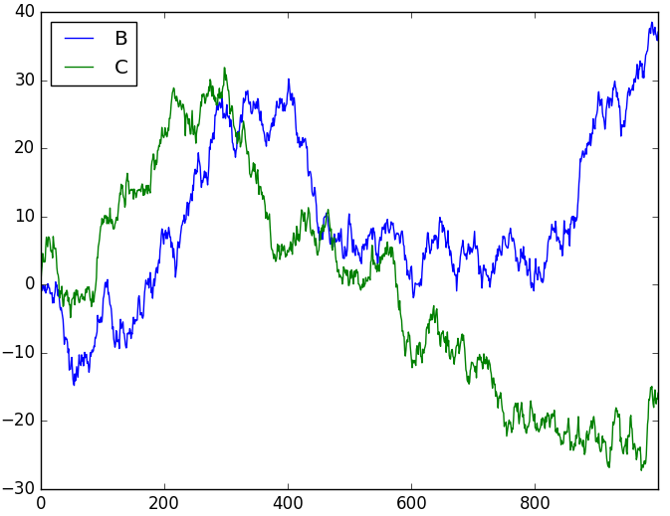
17.4 数据分析模块pandas

Slide 94
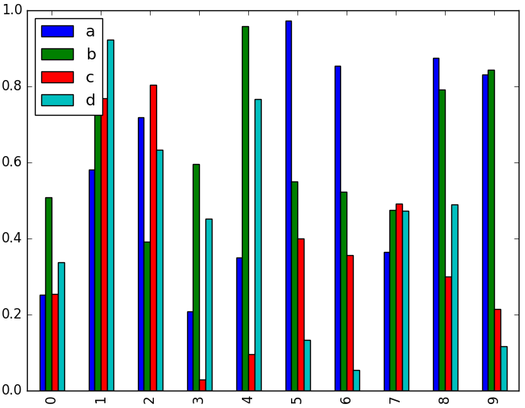
17.4 数据分析模块pandas
>>> df = pd.DataFrame(np.random.rand(10, 4), columns=['a', 'b', 'c', 'd'])
>>> df.plot(kind='bar')
>>> plt.show()

Slide 95
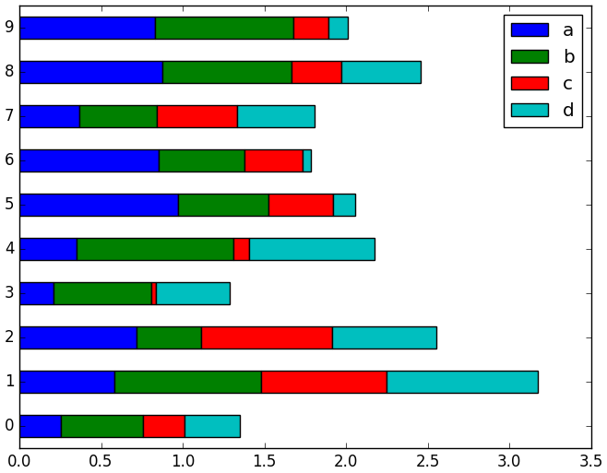
17.4 数据分析模块pandas
>>> df = pd.DataFrame(np.random.rand(10, 4), columns=['a', 'b', 'c', 'd'])
>>> df.plot(kind='barh', stacked=True)
>>> plt.show()

Slide 96
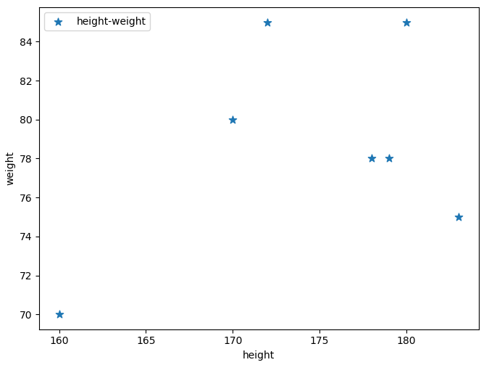
17.4 数据分析模块pandas
>>> df = pd.DataFrame({'height':[180,170,172,183,179,178,160],
'weight':[85,80,85,75,78,78,70]})
>>> df.plot(x='height', y='weight', kind='scatter',
marker='*', s=60, label='height-weight') #绘制散点图atplotlib.axes._subplots.AxesSubplot object at 0x0000020E844CEA20>
>>> plt.show()

Slide 97
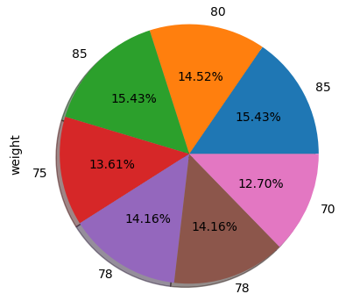
17.4 数据分析模块pandas
>>> df['weight'].plot(kind='pie', autopct='%.2f%%',
labels=df['weight'].values,
shadow=True) # 饼状图
<matplotlib.axes._subplots.AxesSubplot object at 0x0000020E88A11470>
>>> plt.show()

Slide 98
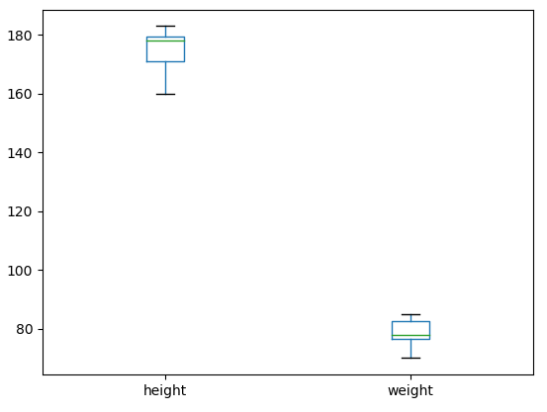
17.4 数据分析模块pandas
>>> df.plot(kind='box') # 箱图，中间50%使用矩形
# 两端的四分之一使用线段
# 异常值使用“o”符号
<matplotlib.axes._subplots.AxesSubplot object at 0x0000020E865B7080>
>>> plt.show()

Slide 99
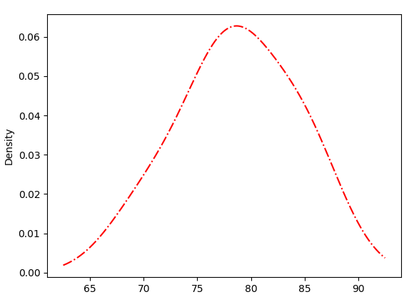
17.4 数据分析模块pandas
>>> df['weight'].plot(kind='kde', style='r-.') # 密度图
<matplotlib.axes._subplots.AxesSubplot object at 0x0000020E88A018D0>
>>> plt.show()

Slide 100
17.4 数据分析模块pandas
（23）文件读写
>>> df.to_excel('d:\\test.xlsx', sheet_name='dfg') # 将数据保存为Excel文件
>>> df = pd.read_excel('d:\\test.xlsx', 'dfg', index_col=None, na_values=['NA'])
>>> df = pd.read_excel('test1.xlsx', 'a',skiprows=3) # 读取a表，跳过前3行
>>> df = pd.read_excel('test1.xlsx', 'a',skiprows=[2,4]) # 跳过下标为2、4的行
>>> df.to_csv('d:\\test.csv') # 将数据保存为csv文件
>>> df = pd.read_csv('d:\\test.csv') # 读取csv文件中的数据

